Slide 2
THE FIBER OPTICS MARKET
Fiber optics are the future of communications and are currently being installed in homes throughout North America
Fiber optics require sophisticated connectors, splitters, and passive devices that transfer a light signal between the source and the recipient
Connectors, splitters, and passive devices are a major profit center in the fiber optics industry
Fiber optics are currently installed in only 5% to 10% of homes in Canada and the United States
Extended temperature splitters DID NOT EXIST… until Valdor’s team designed, created, tested, and manufactured a hermetically sealed product that is immune to humidity and extreme weather factors
2

Slide 3
MARKETS & APPLICATIONS
Valdor serves customers in a variety of diverse markets; meeting the most stringent performance, quality, reliability and RoHS requirements
Telecom/Carrier
PON
Enterprise
CATV
Medical
Commercial/Industrial
Military
Security
3

Slide 4
DELIVERING VALUE FOR CLIENTS
Valdor is focused on understanding every aspect of their clients’ business so that Valdor can maximize and drive value for their clients’ operations and logistical needs
Valdor
Valdor’s
Clients
Clients of Valdor’s Clients
Valdor wants to supply the parts and services to reliably meet their clients’ needs in the most cost-effective manner possible
Valdor
Focus
4

Slide 5
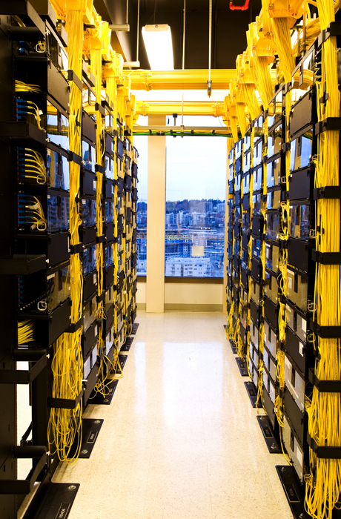
VALDOR’S CAPABILITIES
Solutions derived from innovative, state-of-the-art technologies and proprietary manufacturing techniques
Consulting & Engineering Services
Quick Turn & Prototype Support
Custom Solutions & Redesign
ISO certified offshore manufacturing plant (enables high volume production and quick production ramp-ups)
5

Slide 6
WHAT WE DO…
PRODUCTS & SOLUTIONS
PROJECT CAPABILITIES
Passive Devices
Splitters/Couplers
Attenuators
DWDMs/CWDMs
Telcordia Certified
Support & Services
Commercial Specifications
Industrial Grade
Extended Range Requirements (Includes 1 x n splitter with capacity to handle extreme weather conditions for PON deployments)
Interconnect Solutions
Patch Cords & Cable Assemblies
Enclosures
Termination Kits
Custom Products & Options
6

Slide 7
FINDING SOLUTIONS FOR A MAJOR TELECOM
The Situation: In Q4 of 2012, a major Telecom provider in Canada approached Valdor for help with a serious technical problem in their Fiber to the Home Network
The Challenge: The Telecom’s existing 1:32 splitters across Canada were malfunctioning due to low temperatures (several other vendors were unable to meet the Telecom’s required specifications)
The Solution: Valdor’s Engineering and Manufacturing Team conducted a thorough analysis and came up with an innovative solution that satisfies all of the Telecom provider’s extreme weather specifications
7

Slide 8
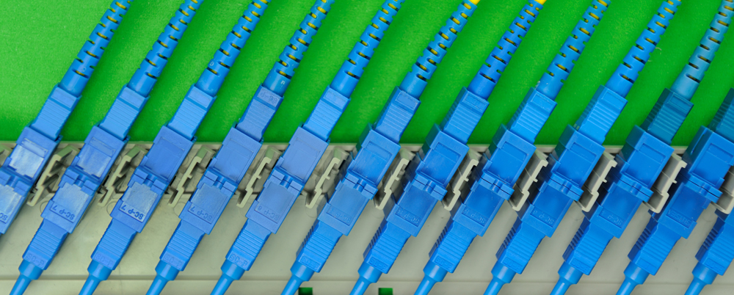
FINDING SOLUTIONS FOR A MAJOR TELECOM
The Canadian Telecom installed several of Valdor’s 1:32 splitters in February 2013
The splitters have been operational since February 2013 with no failures to date
The Telecom has recently made a decision to purchase additional splitters from Valdor
Valdor received its first purchase order from the Canadian Telecom in August 2013
8

Slide 9
FUTURE SALES POTENTIAL
Valdor provides a superior product at a much lower cost to its competitors, while delivering profit margins that are projected to exceed 50%
The Major Telecom that Valdor has partnered with utilizes over $1M in connectors, splitters, and passive devices for annual installation in their Fiber to the Home networks
The Telecom also spends $3M to $5M annually on Patchcords and Rackmount enclosure and cabinets for their central hub and auxiliary networks
Two of Canada’s biggest telecoms, Telus and Bell Canada, are expected to quickly follow suit and begin using Valdor’s cold weather resistant products
Telus and Bell Canada each use 20X as many fiber optic components
Market Potential: The market for Valdor’s connectors, splitters, and passive devices is roughly $100M annually in Canada alone
There are over 800 independent Telcos in the U.S. that are looking for a similar solution
9

Slide 10
KEY PEOPLE
Officers and Directors
Las Yabut
Elston Johnston
Brian Findlay
Ron Boyce
Ralph Kettell
Raj Kapany
President
Chairman and Director
Chief Financial Officer and Director
V.P. of Sales & Marketing and Director
V.P. of Engineering and Director
M & A Specialist and Director
10

Slide 11
SHARE STRUCTURE
Issued
75.7 Million
OUTSTANDING
Warrants
35.1 Million (Exercise Price of $0.20)
Fully Diluted
117 Million
SHARE PRICE
(as of July 15, 2013)
CAD $ 0.16
MARKET CAP
Basic
CAD $ 12.1 Million
AVG. TRADING
(30 day average)
46,611 shares/day
11

Slide 12
VISION & VALUES
Capability – Valdor has qualified professionals at all levels who are prepared to identify and solve the most pressing needs of clients
Durability & Survivability – Valdor’s products are designed and manufactured to the toughest specifications in the industry
Affordability – Valdor has long-standing partnerships & relationships with high-quality, reliable, cost competitive suppliers
Deliverability – Valdor guarantees that it will deliver on time and will meet its promises to customers
Credibility – Valdor’s principal objective is to build strong, enduring relationships with clients that are verifiable from day one
12

Slide 13
CORPORATE INFORMATION
Valdor Technology International Inc.
Suite 450 – 789 West Pender St.
Vancouver, B.C. V6C 1H2
Elston Johnston, Chairman
Tel:604-687-3775
Fax: 604-689-7654
www.valdortech.com
13

